Slide 1
Convolutional Neural Network
Noble Xavier

Slide 2
CNN-INTRODUCTION

Slide 3
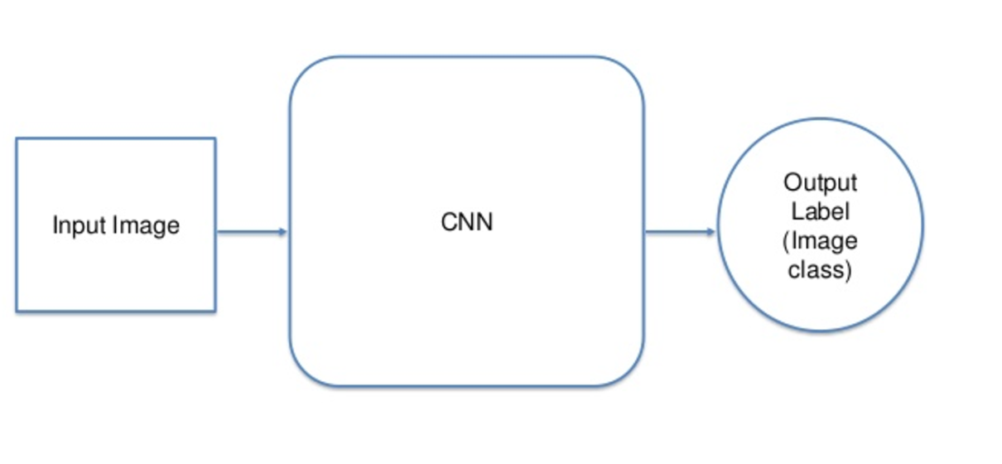
Convolutional Neural Network (CNN)

Slide 4
Convolutional Neural Network (CNN)
A Convolutional Neural Network (CNN) is a type of artificial neural network well-suited for processing images and videos.
It uses a special type of layer called a convolutional layer, which helps the network learn features by applying filters (kernels) to the input data.
Applications:
CNNS are widely used for
image and video analysis
object detection
image classification
natural language processing

Slide 5
Convolutional Neural Network (CNN)
Key Features of a CNN:
Convolutional Layers: These layers use "filters" (kernels) that slide across the input data, extracting features like edges, textures, or shapes.
Pooling Layers: These layers reduce the spatial dimensions of the feature maps, making the network more robust to variations and reducing the number of parameters.
Fully Connected Layers (ANN Dense Layer): These layers, at the end of the network, take the extracted features and make predictions, often using a softmax function for classification.

Slide 6
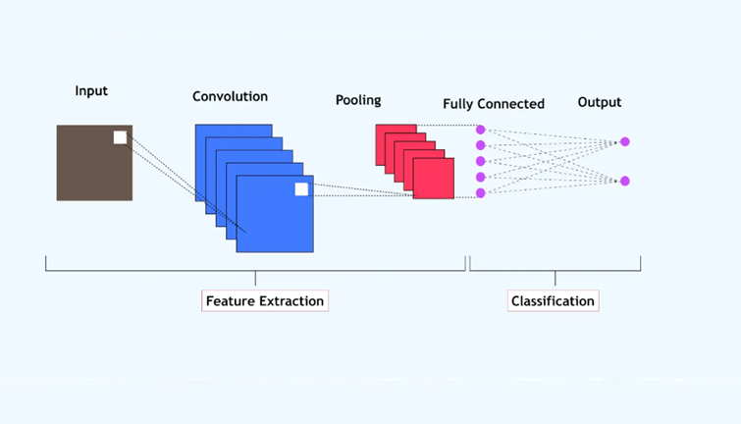
CNN Architecture

Slide 7
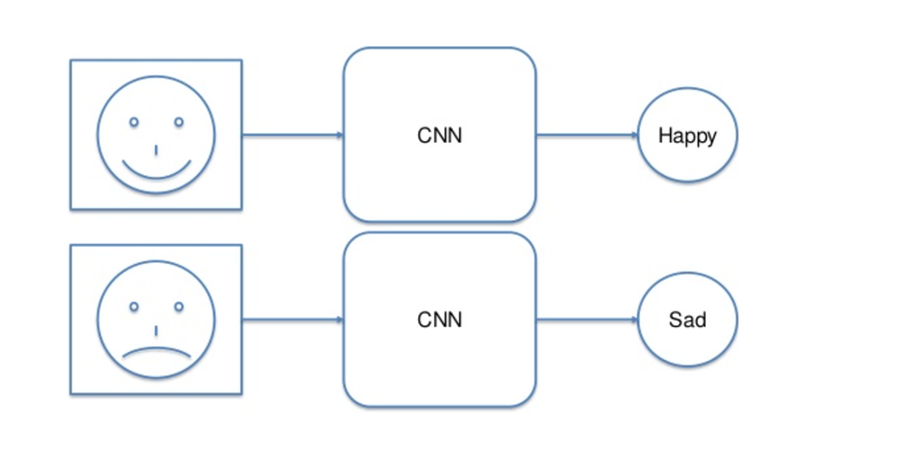
Convolutional Neural Network (CNN)

Slide 8
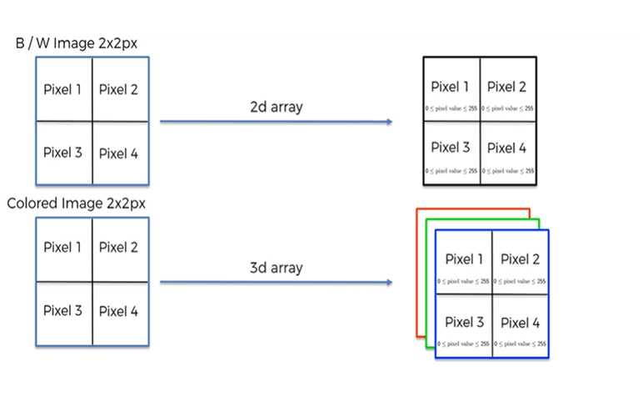
Convolutional Neural Network (CNN)
For a black and white image
0 -> Black
1 – White
For the Colour images, the Pixel will be in the Range of 0 to 256 for three layers (Red, Blue and Green)

Slide 9
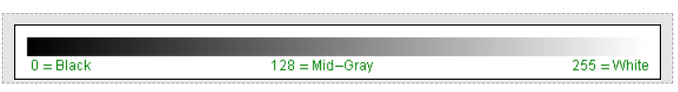
Gray Scale Image
In the context of digital images, grayscale refers to an image where each pixel's value represents a level of intensity, rather than colour information. This results in an image comprised only of shades of gray, ranging from black (lowest intensity) to white (highest intensity).
For a grayscale or b&w image, we have pixel values ranging from 0 to 255. The smaller numbers closer to zero represent the darker shade, while the larger numbers closer to 255 represent the lighter or the white shade.
Grayscale images are a valuable tool in computer vision and are widely used in a range of applications, including object recognition, image analysis, and image processing.
Pixel value ranges from 0 to 255- (0 black and 255 White)

Slide 10
Color Image
An RGB image is a digital image where each pixel's color is defined by a combination of red, green, and blue light values.
Each pixel is represented as a triplet of numbers, one for each color channel.
These values, typically ranging from 0 to 255, determine the intensity of each color, and their combination creates a wide range of colors.
Each pixel in the image is represented by three numerical values, one for each color channel. For example, (255, 0, 0) represents pure red, (0, 255, 0) represents pure green, and (0, 0, 255) represents pure blue.

Slide 11
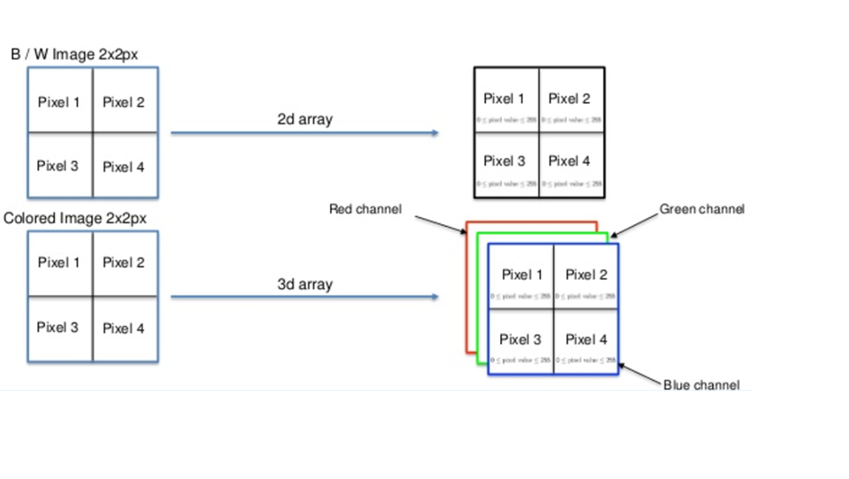
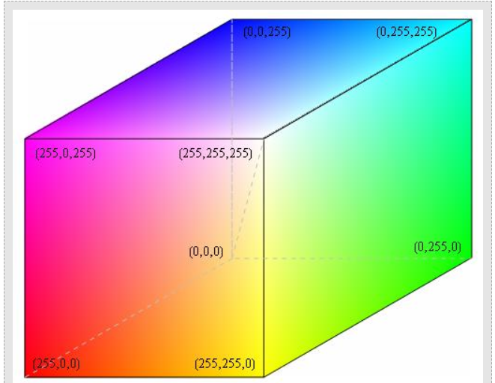
Color Image
Pixel Range of Colour Image

Slide 12
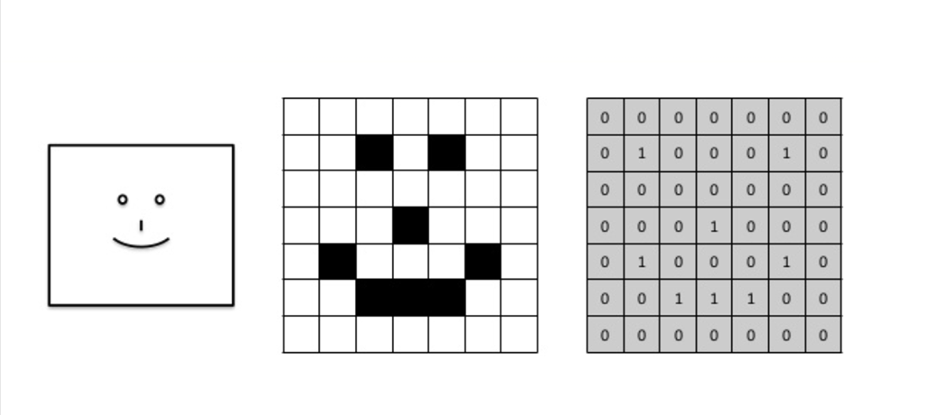
Convolutional Neural Network (CNN)

Slide 13
CNN-STEPS

Slide 14
Convolutional Neural Network (CNN) Steps
Detailed breakdown of the typical CNN steps
Input Layer
Convolutional Layer
Activation Layer
Pooling Layer
Flattening Layer
Fully Connected Layer
Output Layer
Training Layer
Evaluation Layer

Slide 15
STEP 1 – INPUT LAYER

Slide 16
Step 1- Input Layer
This layer receives the raw input data, such as an image.
The input layer is the first layer in the CNN and receives the raw data.
It doesn't perform any calculations on its own.
Its primary function is to hold the input data and pass it to the subsequent convolutional layers.
Input Image Representation:
Height and Width: These dimensions define the spatial resolution of the input image.
Number of Channels: This indicates the depth of the input, representing different colour channels (e.g., 3 for RGB, 1 for grayscale) or other features.

Slide 17
Step 1- Input Layer
Input Shape and Keras:
When building a CNN using libraries like Keras, you need to define the input shape.
This shape is usually passed to the first convolutional layer using the input_shape argument.
For example, Conv2D(filters=32, kernel_size=(3, 3), input_shape=(32, 32, 3)) would define a convolutional layer that expects inputs of shape (32, 32, 3).

Slide 18
STEP 2 – CONVOLUTIONAL LAYER

Slide 19
Step 2- Convolutional Layer
A convolutional layer is the main building block of a CNN.
It contains a set of filters (or kernels), parameters of which are to be learned throughout the training.
The size of the filters is usually smaller than the actual image. Each filter convolves with the image and creates an activation map.

Slide 20
Step 2- Convolutional Layer
Steps in a Convolution Layer
Initialize Filters: Randomly initialize a set of filters with learnable parameters.
Convolve Filters with Input: Slide the filters across the width and height of the input data, computing the dot product between the filter and the input sub-region.
Apply Activation Function: Apply a non-linear activation function to the convolved output to introduce non-linearity.
Pooling (Optional): Often followed by a pooling layer (like max pooling) to reduce the spatial dimensions of the feature map and retain the most important information.

Slide 21
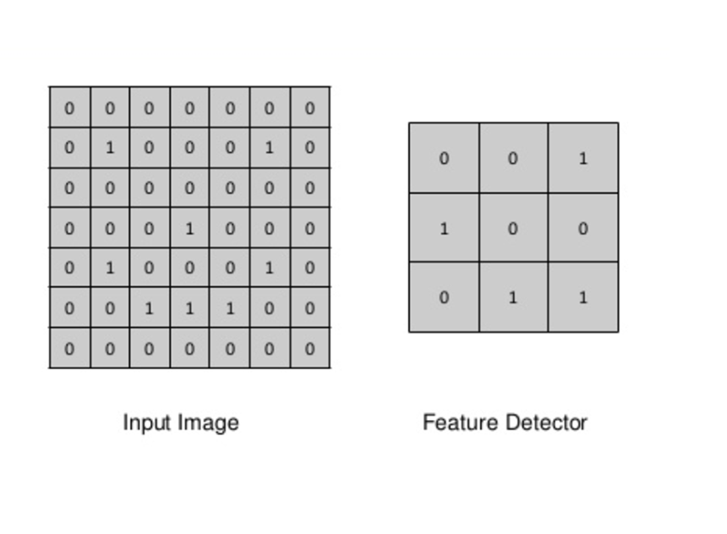
Step 2- Convolutional Layer
Feature Detector, also called Kernel or Filter

Slide 22
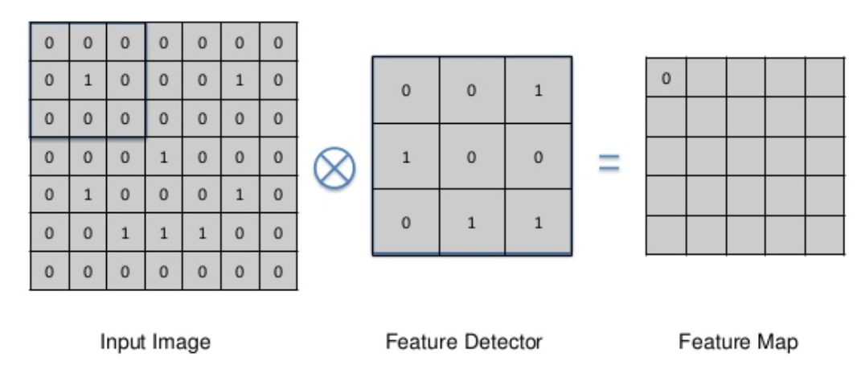
Step 2- Convolutional Layer
Multiply the feature Detector value with input image session, then add all the values to populate feature map

Slide 23
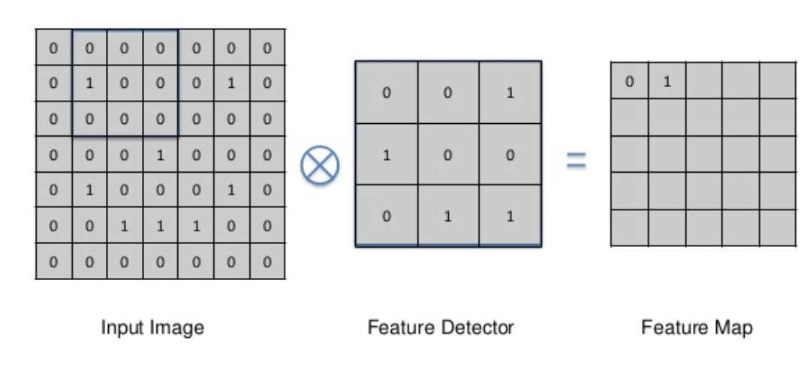
Step 2- Convolutional Layer
Here, one cell is matching, so the feature map has the value 1

Slide 24
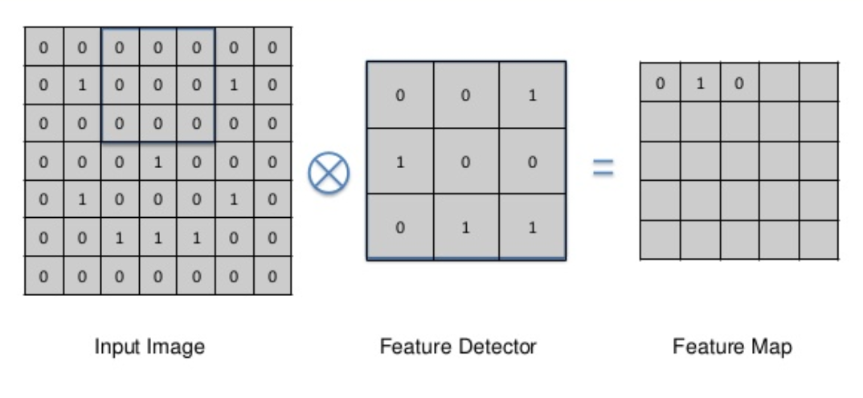
Step 2- Convolutional Layer

Slide 25
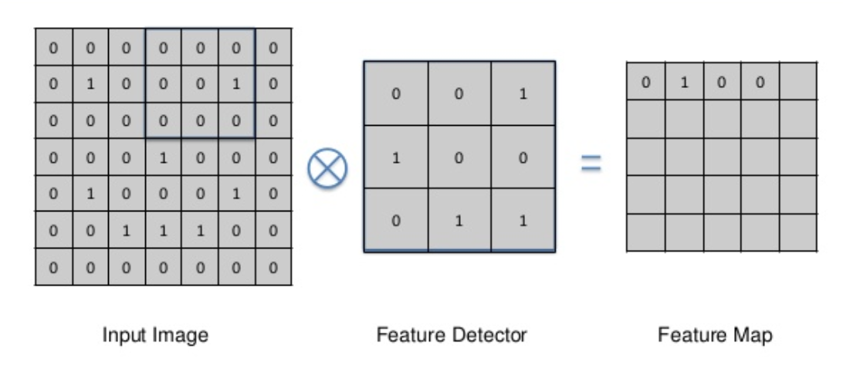
Step 2- Convolutional Layer

Slide 26
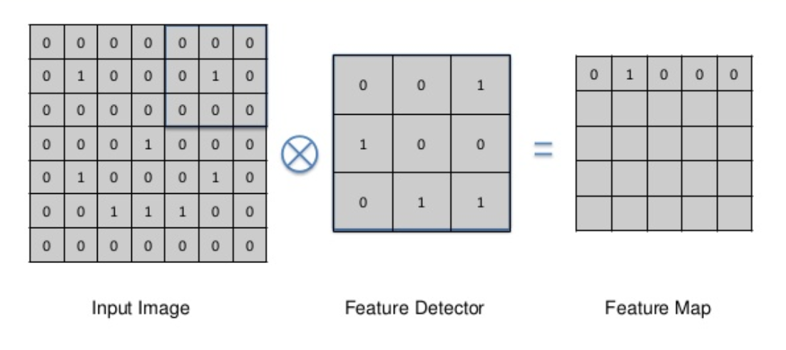
Step 2- Convolutional Layer

Slide 27
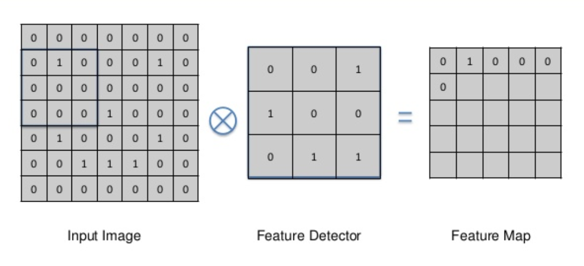
Step 2- Convolutional Layer

Slide 28
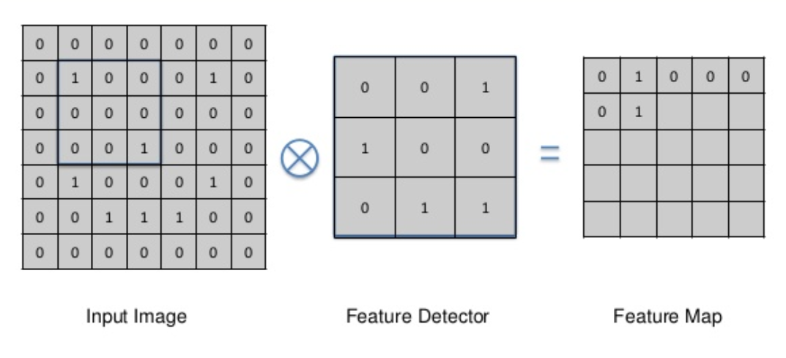
Step 2- Convolutional Layer

Slide 29
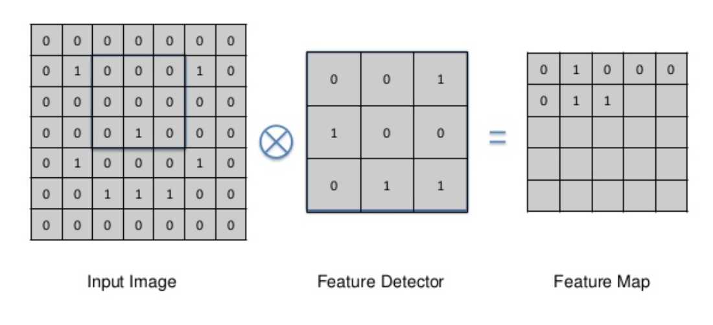
Step 2- Convolutional Layer

Slide 30
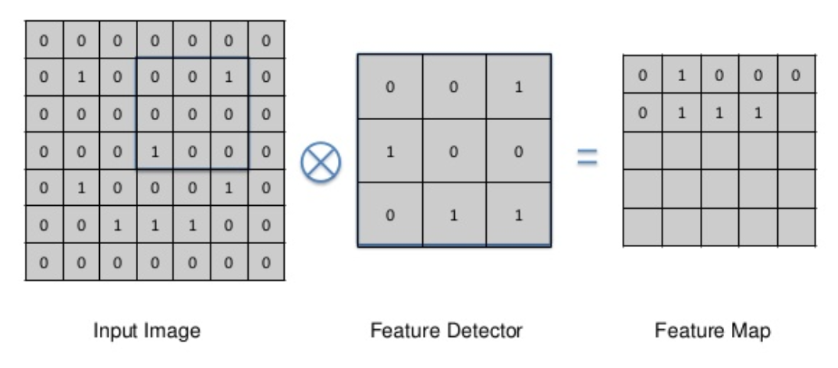
Step 2- Convolutional Layer

Slide 31
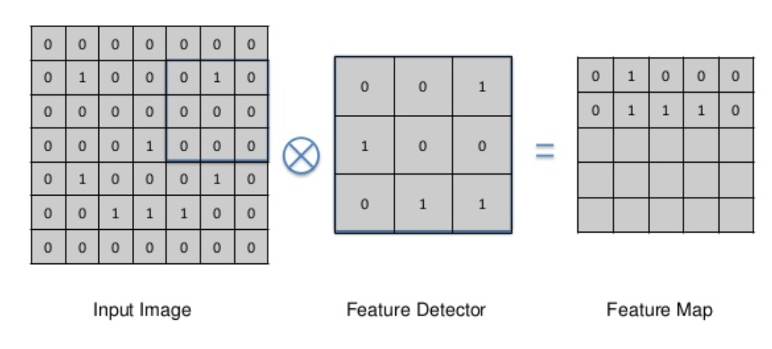
Step 2- Convolutional Layer

Slide 32
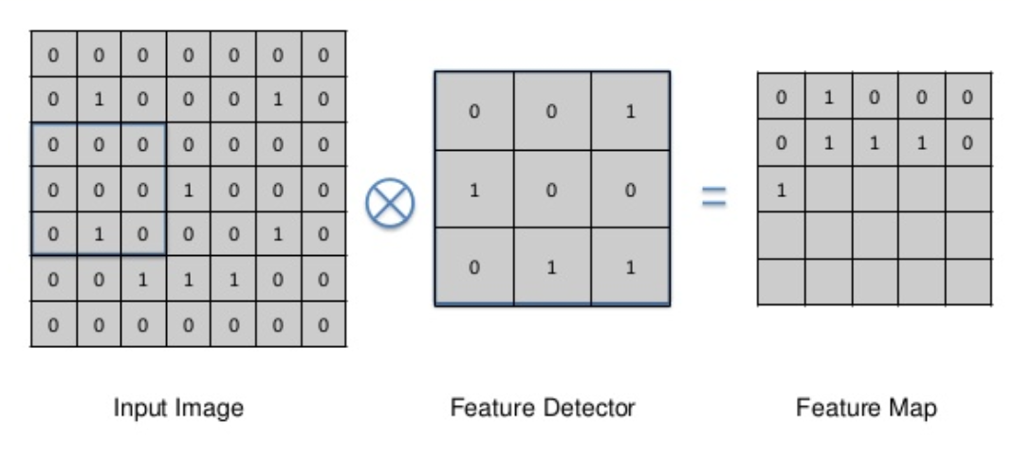
Step 2- Convolutional Layer

Slide 33
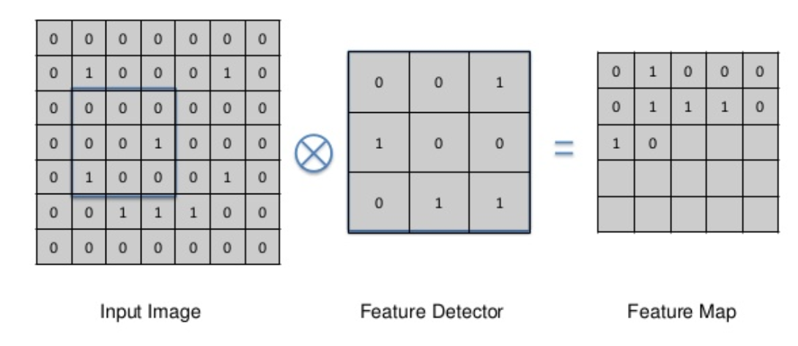
Step 2- Convolutional Layer

Slide 34
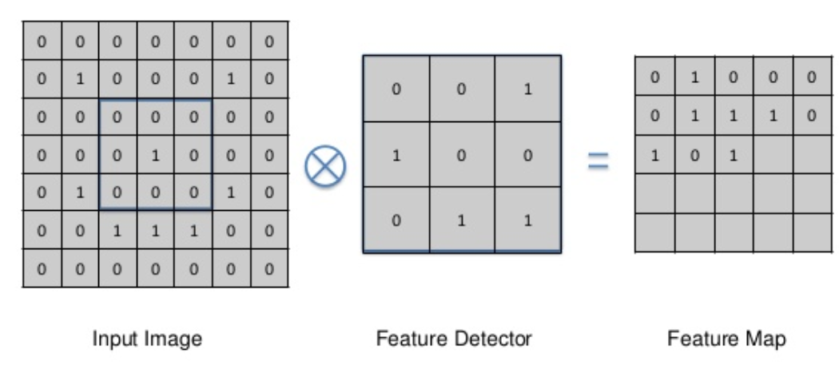
Step 2- Convolutional Layer

Slide 35
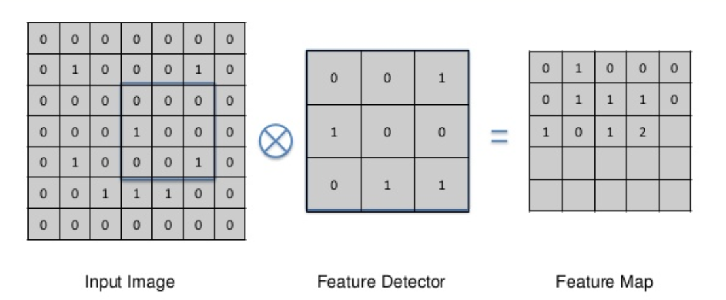
Step 2- Convolutional Layer

Slide 36
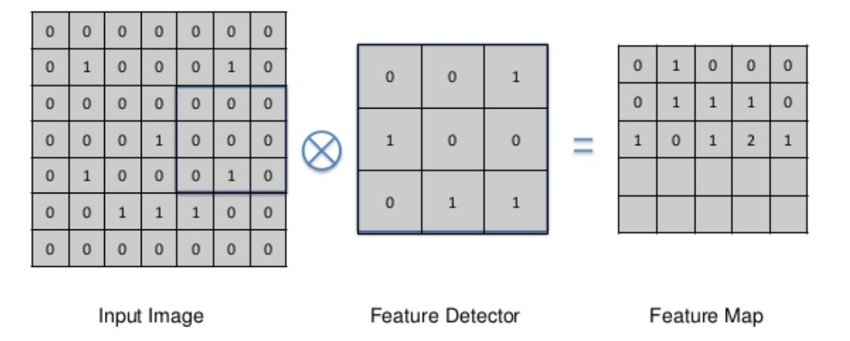
Step 2- Convolutional Layer

Slide 37
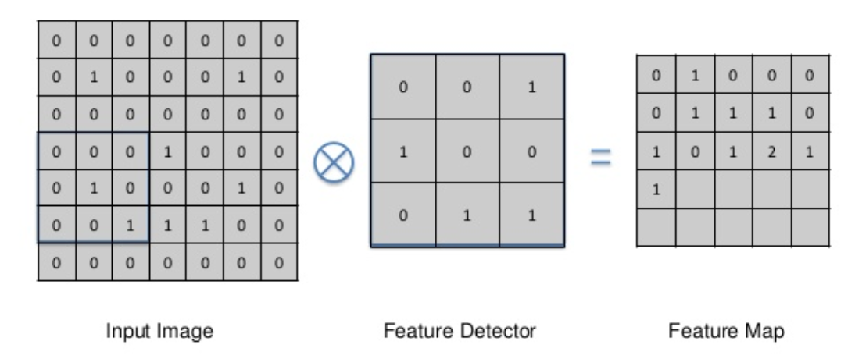
Step 2- Convolutional Layer

Slide 38
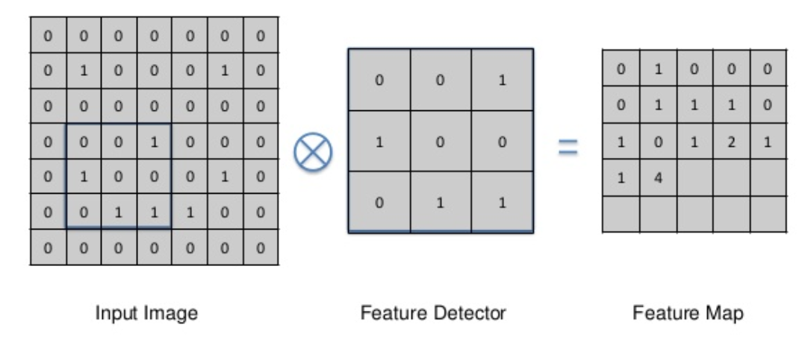
Step 2- Convolutional Layer

Slide 39
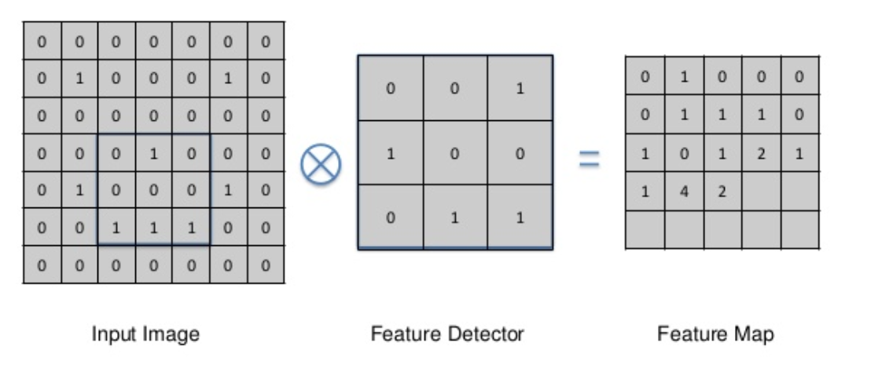
Step 2- Convolutional Layer

Slide 40
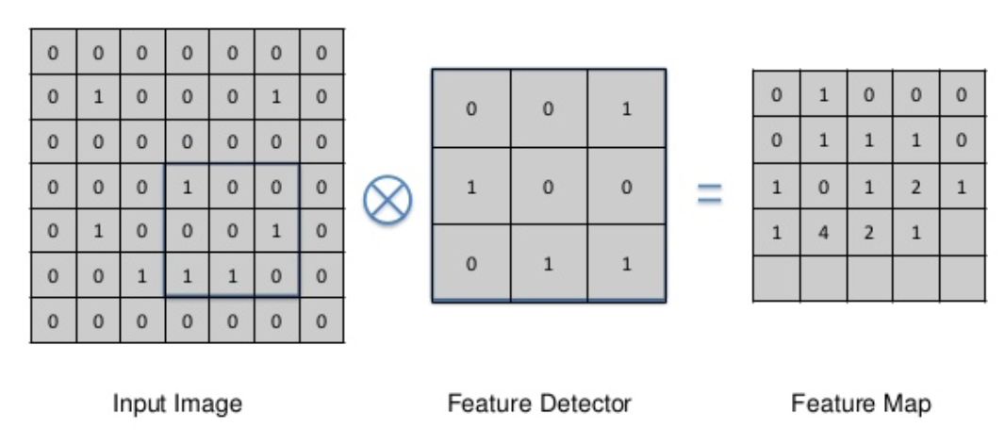
Step 2- Convolutional Layer

Slide 41
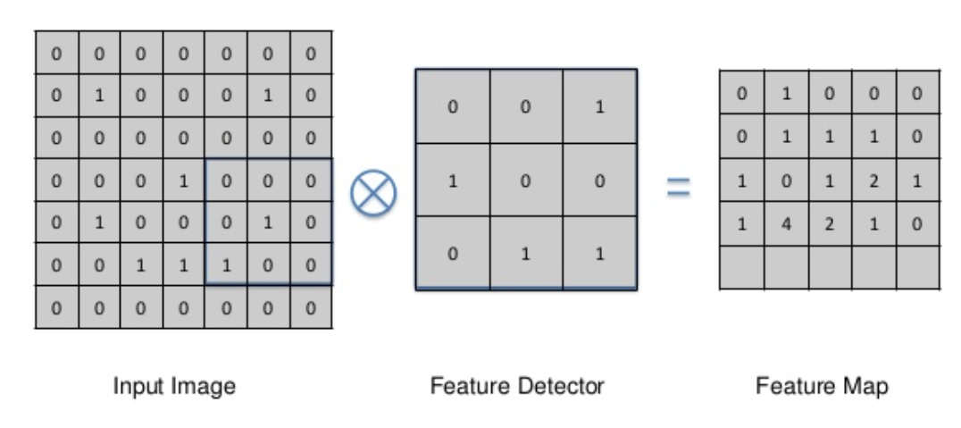
Step 2- Convolutional Layer

Slide 42
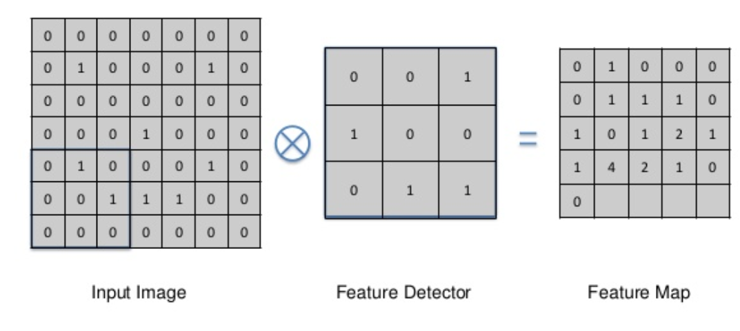
Step 2- Convolutional Layer

Slide 43
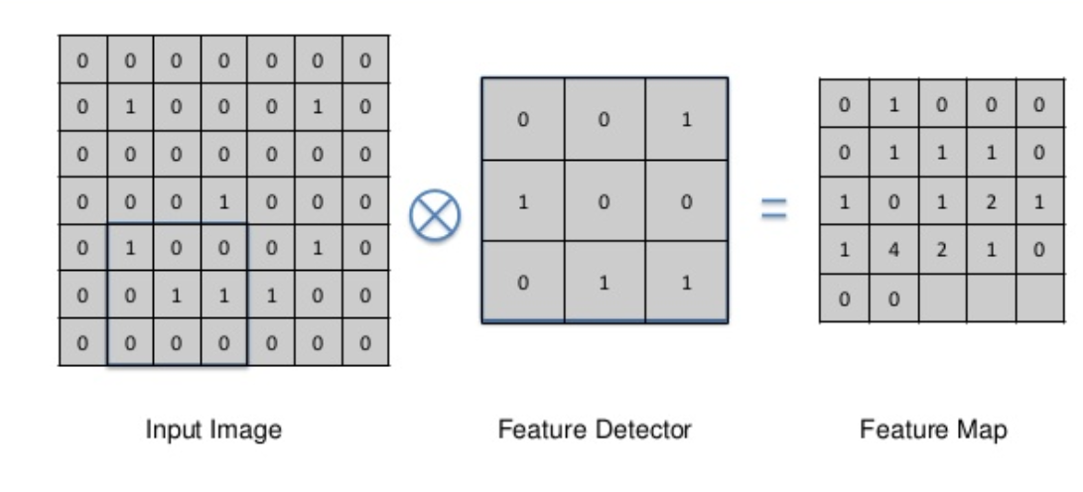
Step 2- Convolutional Layer

Slide 44
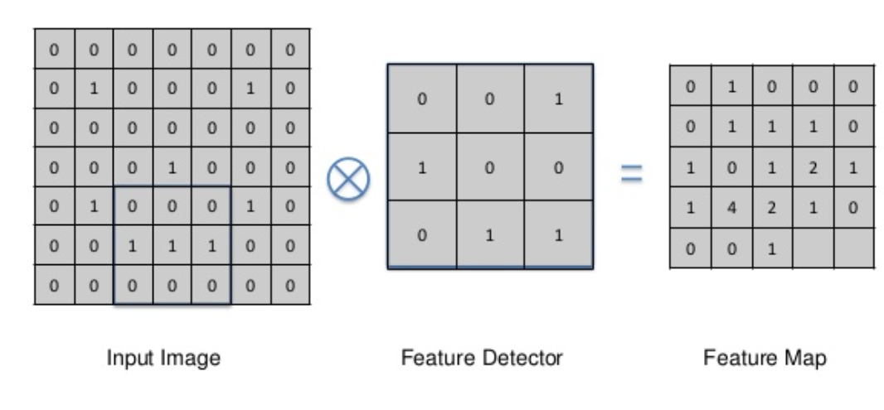
Step 2- Convolutional Layer

Slide 45
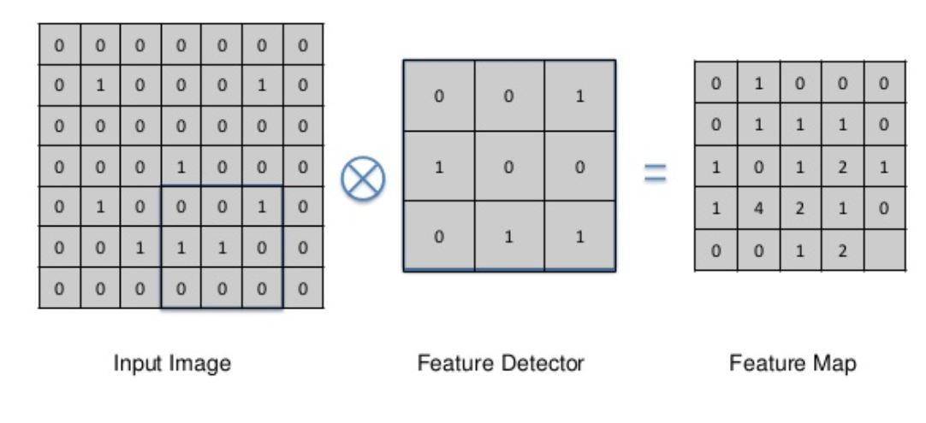
Step 2- Convolutional Layer

Slide 46
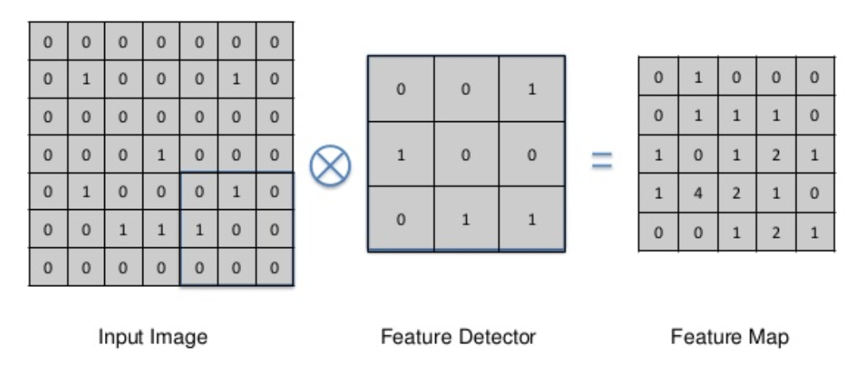
Step 2- Convolutional Layer

Slide 47
Step 2- Convolutional Layer
Advantages of Feature Detection
Reduce the Size
Highlight Certain Features in a certain part of the image
The highest number is the feature map, which shows that it matches exactly

Slide 48
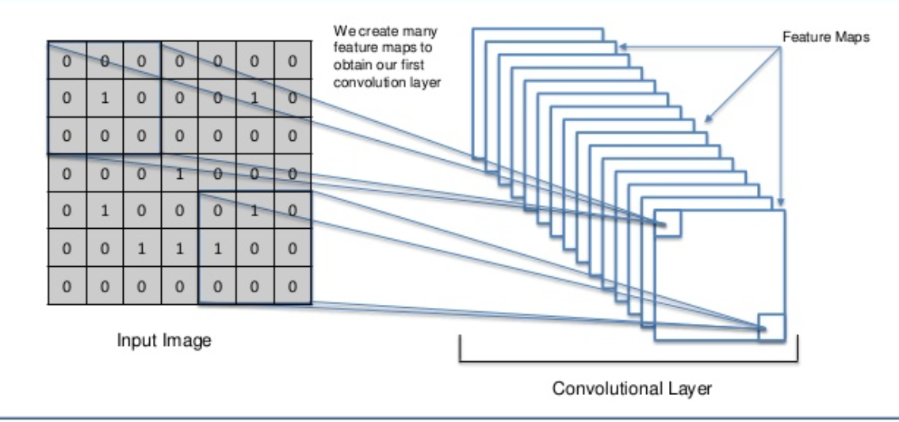
Step 2- Convolutional Layer
Create Multiple Feature Maps

Slide 49
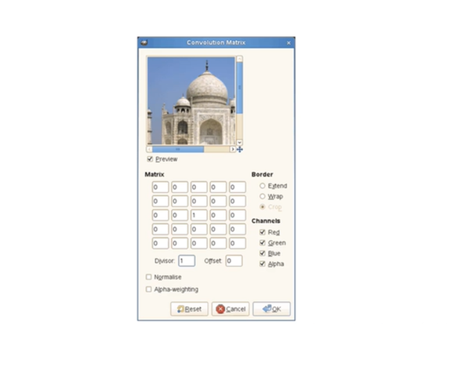
Step 2- Convolutional Layer

Slide 50
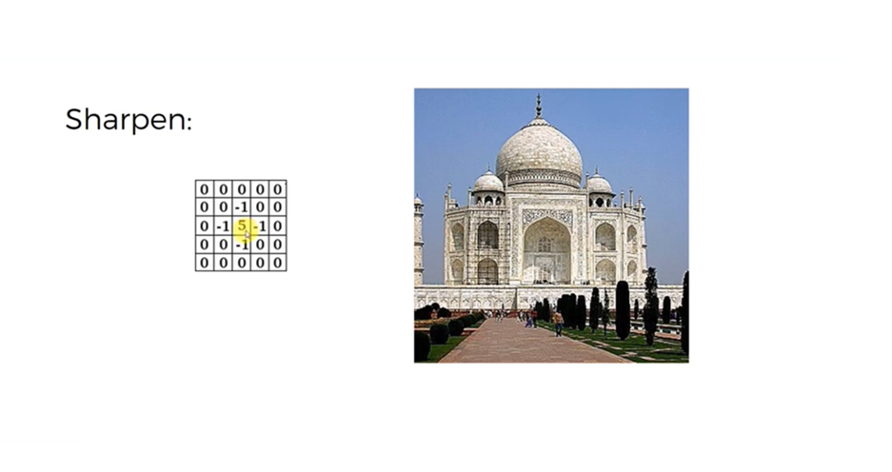
Step 2- Convolutional Layer

Slide 51
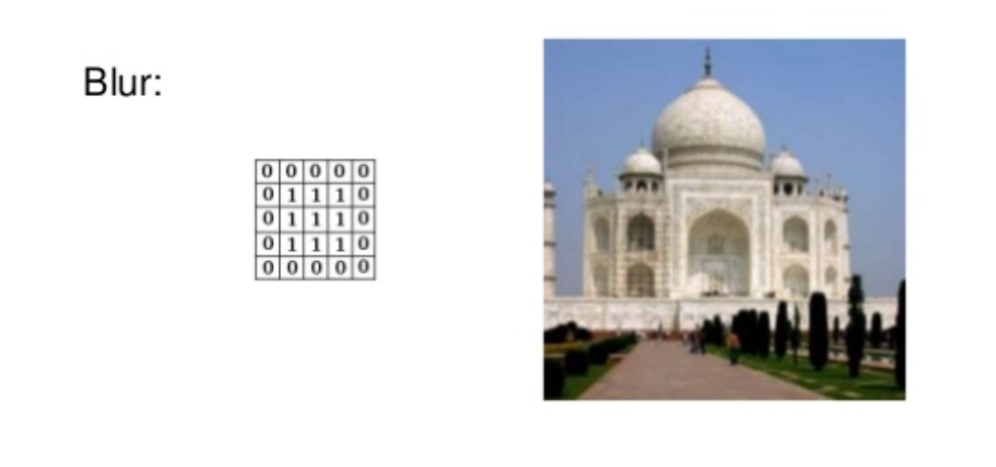
Step 2- Convolutional Layer

Slide 52
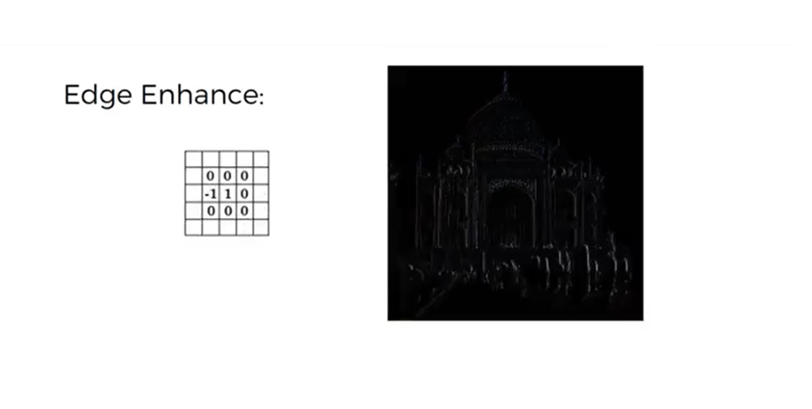
Step 2- Convolutional Layer

Slide 53
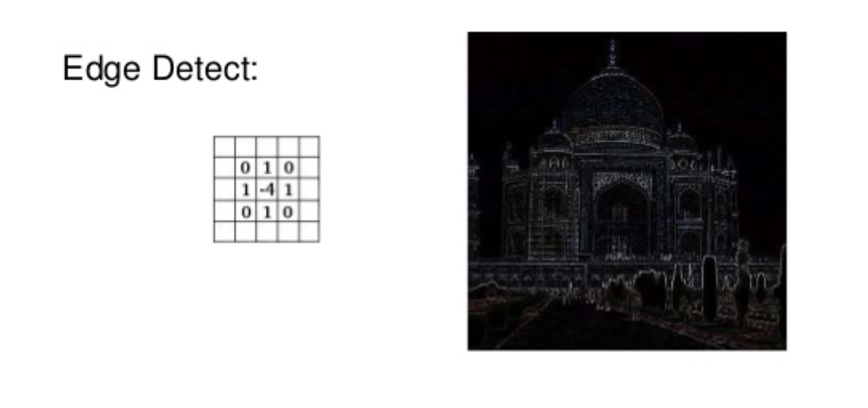
Step 2- Convolutional Layer

Slide 54
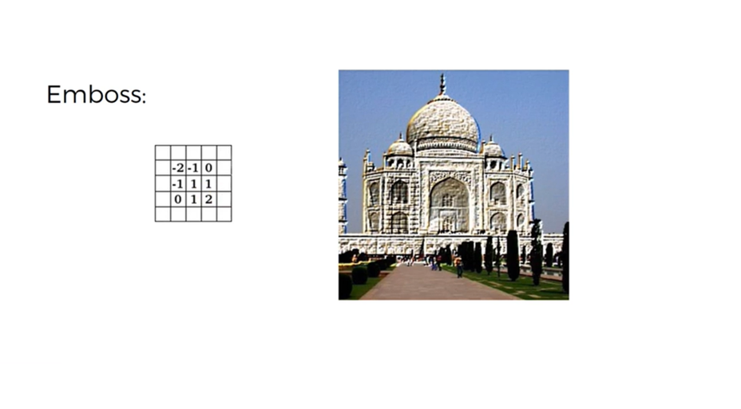
Step 2- Convolutional Layer

Slide 55
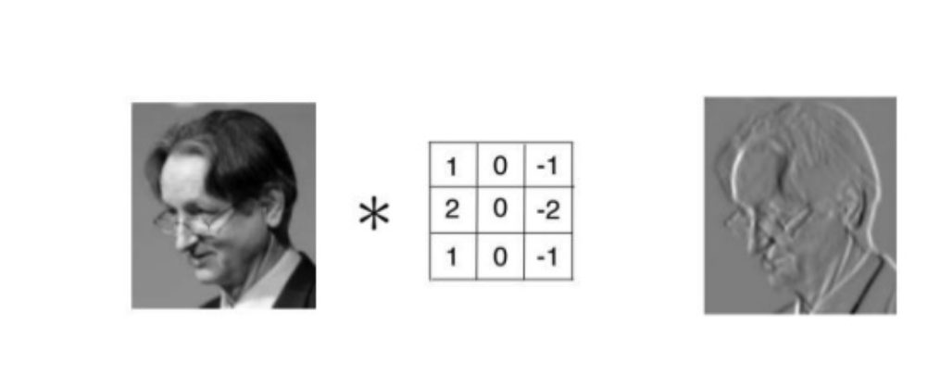
Step 2- Convolutional Layer

Slide 56
STEP 3 – ACTIVATION LAYER

Slide 57
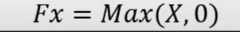
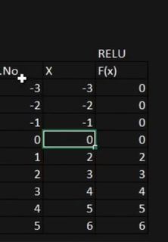
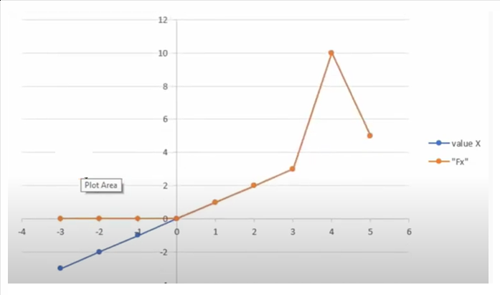
ReLU: Rectifier Linear Unit Function Layer
ReLU has only non-negative values, Negative values will be converted to Zero (0)
( This used to reduce linearity)
Example

Slide 58
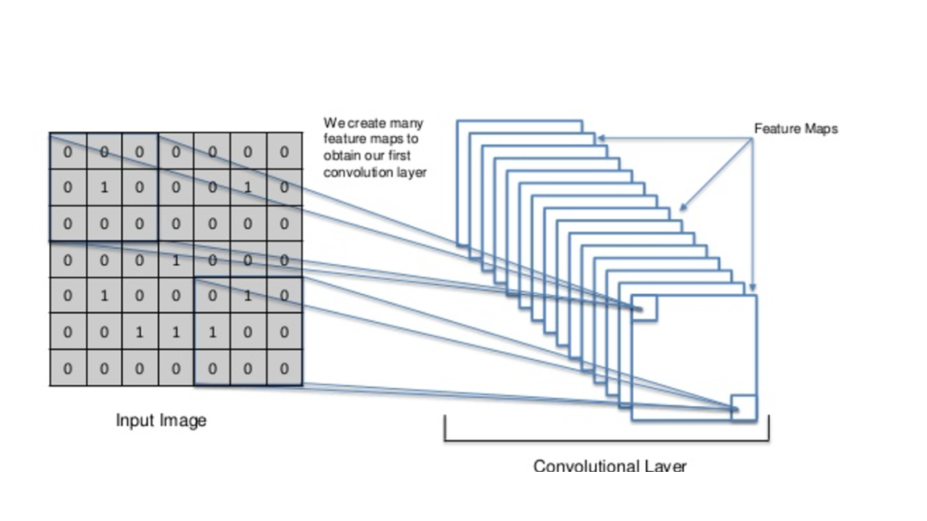
ReLU: Rectifier Linear Unit Function Layer

Slide 59
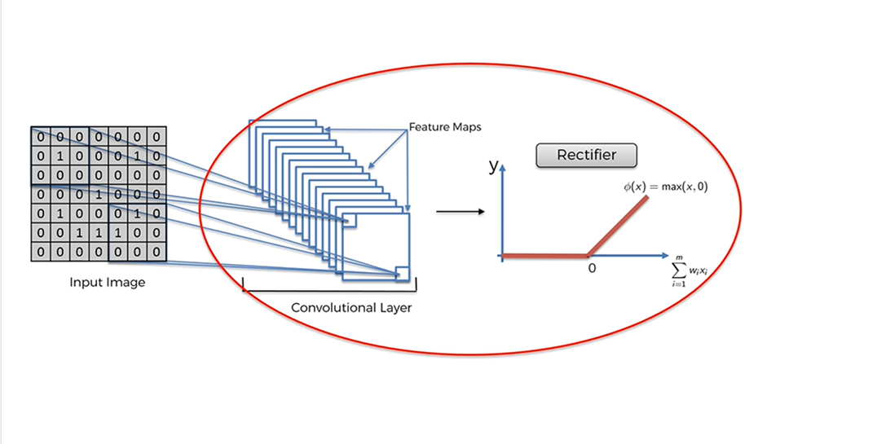
ReLU: Rectifier Linear Unit Function Layer
Rectifier increases non-linearity

Slide 60
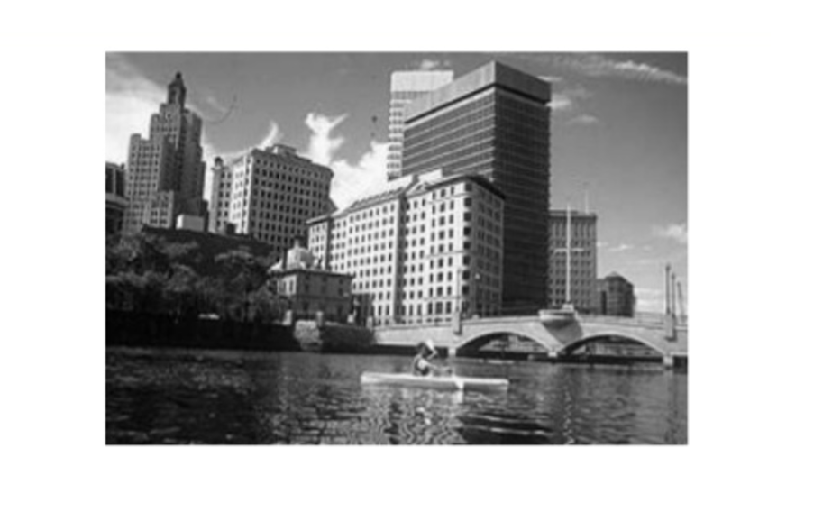
ReLU: Rectifier Linear Unit Function Layer

Slide 61
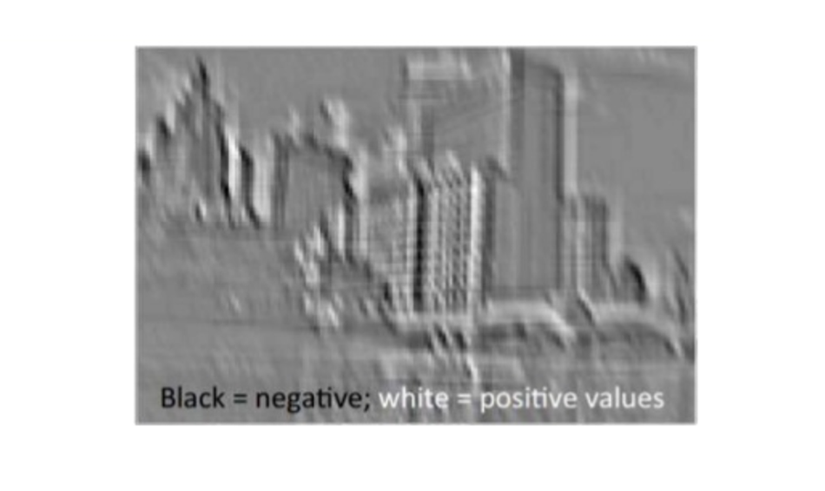
ReLU: Rectifier Linear Unit Function Layer
After applying ReLU , it removes all back (Remove Negative)

Slide 62
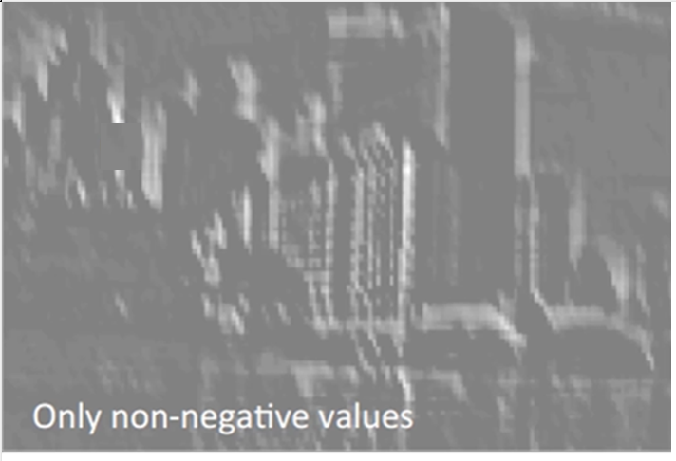
ReLU: Rectifier Linear Unit Function Layer

Slide 63

ReLU: Rectifier Linear Unit Function Layer

Slide 64

ReLU: Rectifier Linear Unit Function Layer

Slide 65


Activation Functions

Slide 66
STEP 4 – POOLING LAYER

Slide 67
Pooling Layer
Pooling Layer typically used after the convolutional layer to reduce the spatial (width and height)dimensions of feature maps and decrease the data volume and parameter count.
It does this by aggregating information from nearby pixels into a single value, typically using max pooling or average pooling. This down sampling process helps reduce computation, control overfitting, and make the network more robust to variations in input.

Slide 68
Pooling Layer
Key points about pooling layers
Dimensionality Reduction: Pooling layers reduce the spatial dimensions (width and height) of the feature maps.
Feature Aggregation: They aggregate information from nearby pixels, like taking the maximum or average value within a region.
Translation Invariance: Pooling makes the network more robust to small shifts or changes in input location.
Computational Efficiency: By reducing the size of feature maps, pooling layers also reduce the amount of computation needed.

Slide 69
Types of Pooling
Max Pooling : Max pooling selects the maximum value within a specified region of the feature map.
Average Pooling: Average pooling calculates the average of all values within a specified region of the feature map.
Global Pooling: Global pooling applies max or average pooling across the entire feature map, resulting in a single value per feature map. Global Max Pooling and Global Average Pooling.
Sum Pooling: Calculates the sum of all values within a region.
Stochastic Pooling: Inspired by dropout, it randomly selects values within a region based on their probability, offering a more flexible approach.
Region of Interest (RoI) Pooling: A technique used in object detection to extract fixed-size feature maps from variable-sized regions.

Slide 70
Max Pooling- Steps
Input Feature Map: Max pooling takes as input a feature map produced by a convolutional layer.
This feature map represents the activations or output of the convolutional layer.
Pooling Window: A rectangular window, typically 2x2, is used to divide the input feature map into smaller, non-overlapping regions.
Maximum Value Selection: Within each region, max pooling selects the maximum value and ignores all other values in that region.
Down sampling: The selected maximum values are then used to create a new, smaller feature map, effectively reducing the spatial dimensions of the original feature map.
Stride: The stride determines the step size between consecutive pooling windows.
A stride of 2 means the windows are non-overlapping, while a stride of 1 means the windows overlap.

Slide 71

Max Pooling
How to identify the Cheetah, even though their directions are different

Slide 72

Max Pooling
How to identify the Cheetah, even though their directions/images are different

Slide 73

Max Pooling

Slide 74

Max Pooling

Slide 75

Max Pooling
Select the Maximum value from the 2 X 2 area.

Slide 76

Max Pooling

Slide 77

Max Pooling

Slide 78

Max Pooling

Slide 79

Max Pooling

Slide 80

Max Pooling

Slide 81

Max Pooling

Slide 82

Max Pooling

Slide 83

Max Pooling
Pooling reduces overfitting, reduces the size
It preserves the features, it reduces the parameters.
Other Pooling Methods
Sum Pooling
Average Pooling /Mean

Slide 84

Max Pooling

Slide 85

Max Pooling
https://www.cs.ryerson.ca/~aharley/vis/conv/

Slide 86
STEP 5 – FLATTENING LAYER

Slide 87
Flattening
In Convolutional Neural Networks (CNNs), the Flatten layer converts multi-dimensional output (like feature maps after convolution and pooling) into a one-dimensional vector.
This transformation is necessary because fully connected layers, which typically follow convolutional layers in a CNN, require 1D input.
This flattened representation can then be passed to fully connected layers for further processing and prediction.

Slide 88

Flattening

Slide 89

Flattening

Slide 90

Flattening

Slide 91

Flattening

Slide 92
STEP 6 – FULLY CONNECTED LAYER

Slide 93
Full Connection
A fully connected layer, also known as a dense layer, is a type of neural network layer where every neuron in the layer is connected to every neuron in the previous and subsequent layers.
This complete connectivity means that each neuron in a layer processes information from every neuron in the preceding layer.

Slide 94
Full Connection
How it works:
Input: The layer receives input from the previous layer (or the initial input data).
Linear Transformation: Each neuron multiplies its input by a corresponding weight in the weight matrix and adds a bias.
Activation Function: An activation function (e.g., ReLU, sigmoid, tanh) is applied to the output of the linear transformation.
Output: The activated output becomes the input to the next layer.

Slide 95

Full Connection

Slide 96

Full Connection

Slide 97

Full Connection

Slide 98

Full Connection

Slide 99

Full Connection

Slide 100

Full Connection

Slide 101

Full Connection

Slide 102

Full Connection

Slide 103

Full Connection

Slide 104

Full Connection

Slide 105

Full Connection

Slide 106

Full Connection

Slide 107

Summary

Slide 108
STEP 7 – OUTPUT LAYER

Slide 109

Softmax
The outputs of the Softmax transform are always in the range [ 0 , 1 ] [0, 1] [0,1] and add up to 1. Hence, they form a probability distribution.
The softmax function is often used in the final layer of a neural network-based classifier.

Slide 110

Softmax
The output values are between the range [0,1] which is nice because we are able to avoid binary classification and accommodate as many classes or dimensions in our neural network model.
This is why softmax is sometimes referred to as a multinomial logistic regression.

Slide 111

Cross Entropy
Cross-entropy loss, or log loss, measures the performance of a classification model whose output is a probability value between 0 and 1.
Cross-entropy loss increases as the predicted probability diverges from the actual label.

Slide 112

Cross Entropy
Cross entropy can be used to define a loss function (cost function) in machine learning and optimization.
It is defined on probability distributions, not single values. It works for classification because classifier output is (often) a probability distribution over class labels.

Slide 113

Softmax and Cross Entropy
NN1 performs better than NN2

Slide 114

Softmax and Cross Entropy

Slide 115

Cross Entropy
Cross-entropy loss also known as log loss is a metric used in machine learning to measure the performance of a classification model. Its value ranges from 0 to 1 with lower being better. An ideal value would be 0.
The goal of an optimizer tasked with training a classification model with cross-entropy loss would be to get the model as close to 0 as possible.

Slide 116
STEP 8 – TRAINING LAYER

Slide 117
Training Layer
In Convolutional Neural Networks (CNNs), model training is the process of adjusting the network's parameters (weights and biases) using a dataset of labeled images to learn how to associate images with their correct labels.
The training process for a CNN involves the following steps:
Data Preparation: The training images are preprocessed to ensure that they are all in the same format and size.
Loss Function: A loss function is used to measure how well the CNN is performing on the training data.

Slide 118
STEP 9 – EVALUATION LAYER

Slide 119
Evaluation Layer
After training a CNN, its performance is assessed on a test set that the model hasn't seen during training.
This allows for an unbiased evaluation of the model's generalization ability.
Common metrics used for evaluating CNNs include:
Accuracy: The percentage of test images correctly classified.
Precision: The percentage of test images predicted as a specific class that are actually of that class.
Recall: The percentage of test images of a specific class that are correctly classified by the model.
F1-score: The harmonic mean of precision and recall, useful for imbalanced datasets.

Slide 120
SUMMARY

Slide 121

Reads the Image

Slide 122

Fully Connected Networks

Slide 123

Convolutional Neural Networks

Slide 124

Woking of CNN

Slide 125

Trickier Case

Slide 126

Woking of CNN

Slide 127

Woking of CNN

Slide 128

Woking of CNN

Slide 129

Woking of CNN

Slide 130

Woking of CNN

Slide 131

Woking of CNN

Slide 132

Steps Involved in Convolutional Layer

Slide 133

Multiplying the Corresponding Pixel Values

Slide 134

Multiplying the Corresponding Pixel Values

Slide 135

Steps Involved in Convolution Layer

Slide 136

Adding and Dividing by the Total Number of Pixels

Slide 137

Creating a Map to put the Value of the Filter

Slide 138

Sliding the Filter throughout the image

Slide 139

Convolution Layer

Slide 140

Convolution Layer Output

Slide 141

Convolution Layer Output

Slide 142

ReLU Layer

Slide 143

Removing the Negative Values

Slide 144

Removing the Negative Values

Slide 145

Output for One Feature

Slide 146

Output for All Features

Slide 147

Pooling Layer

Slide 148

Calculating the Maximum Value in each Window

Slide 149

Moving the Window Across the Entire Image

Slide 150

Output After Passing Through Pooling Layer

Slide 151

Staking up with Layers

Slide 152

Staking up with Layers

Slide 153

Fully Connected Layer

Slide 154

Output

Slide 155

Prediction

Slide 156

Prediction

Slide 157

Comparing the input Vector with X

Slide 158

Comparing the input Vector with ‘O’

Slide 159

Result

